Slide 1
Feeding Lots Data to Language Models
CSCI 601-771 (NLP: Self-Supervised Models)
https://self-supervised.cs.jhu.edu/sp2025/

Slide 2
Logistics update
By popular demand, project proposal deadline is pushed to Monday, Apr 1.
Addressing a question:
“I want to build an application X via prompt-engineering”
Depending on what you mean by “Prompt-engineering” it can be something that high-school kids can do as well.
So, you need to argue either of these: (1) this is a non-trivial ”engineering”; or (2) it’s a compelling application.
Clarification on “default” ideas:
There are ways to go about these without massive compute.
For example, for the ideas involving positional encodings we have provided links to prior implementations that you can use.
If they seem complex or unclear, feel free to ask me or TA.

Slide 3
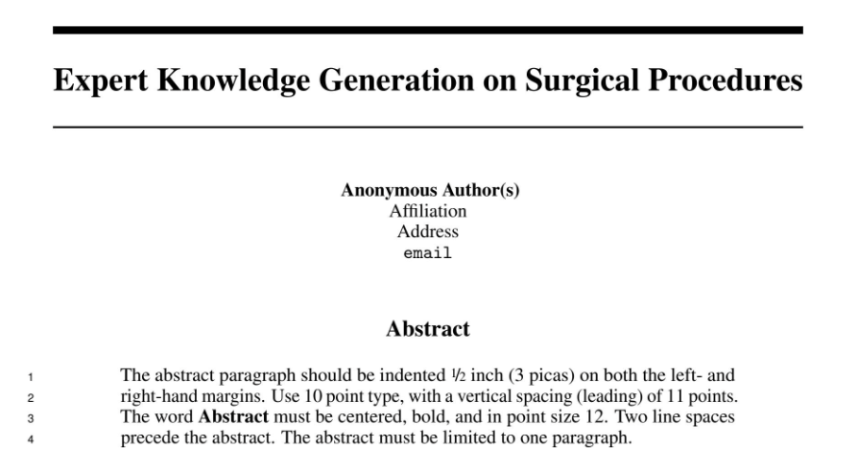
More on Proposals
Anonymous? :)
No abstract? :)

Slide 4
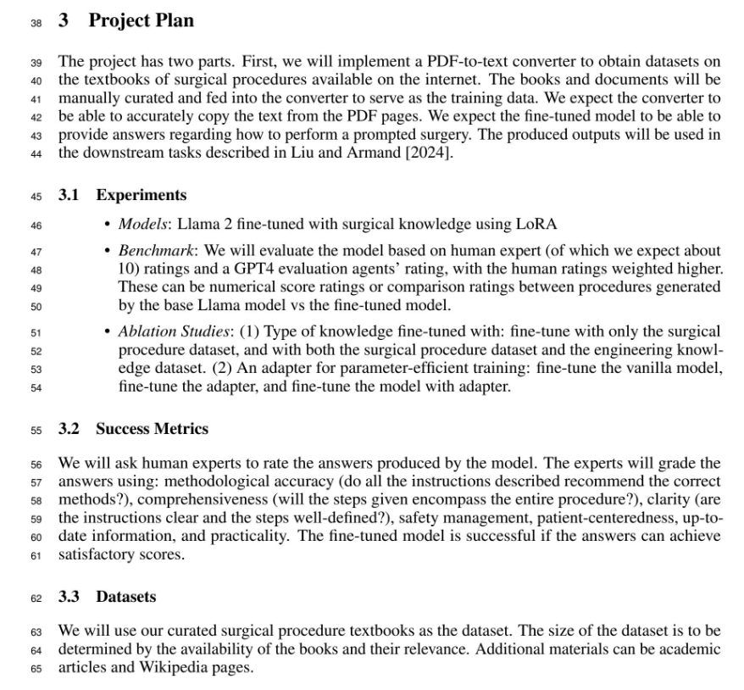
More on Proposals
What is the input to your system?
“our curated surgical procedures”: → show an example
Dataset: have you thought about using existing datasets?

Slide 5
This is NOT Just an Academic Exercise
Imagine you’re in a tech company.
You need to write memos, reports and proposals for before or after any project.
Jeff Bezos: “There is no way to write a six-page narratively structured memo and not have clear thinking.”
https://medium.com/@nathan.baugh/welcome-to-the-jungle-38fdde285b6f
https://writingcooperative.com/the-anatomy-of-an-amazon-6-pager-fc79f31a41c9

Slide 6
Back to our topic

Slide 7
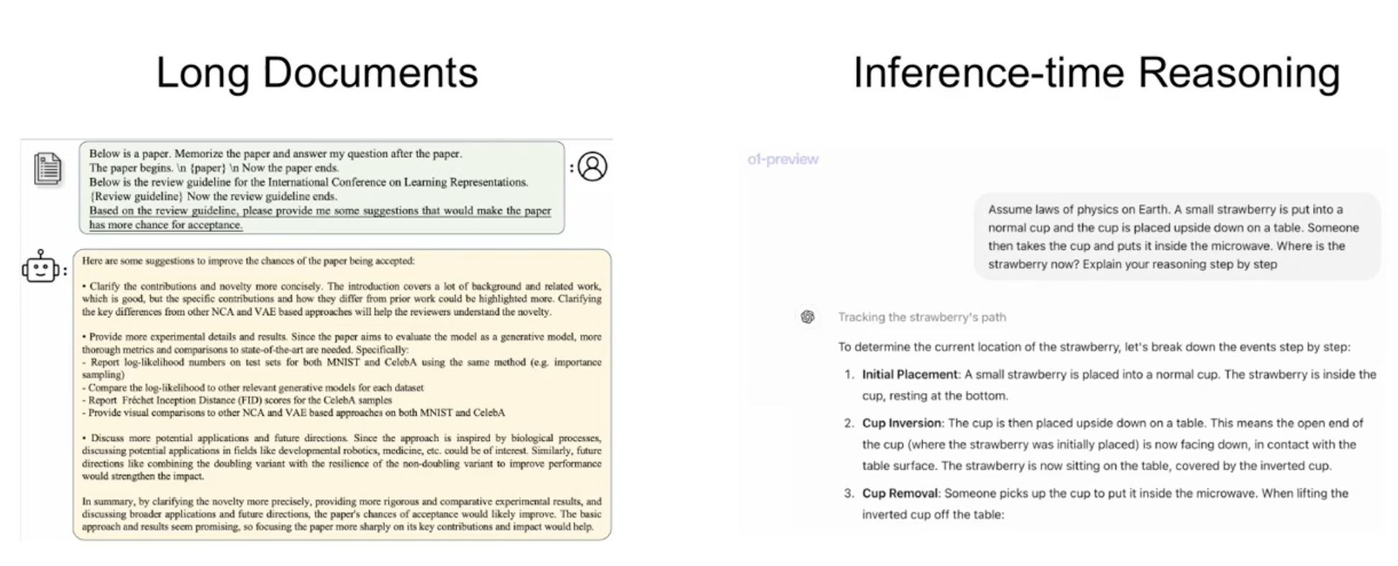
Long inputs/outputs in LM
Books, scientific articles, government reports, videos, your daily experience, etc. they all are much longer than 10k tokens!!

Slide 8
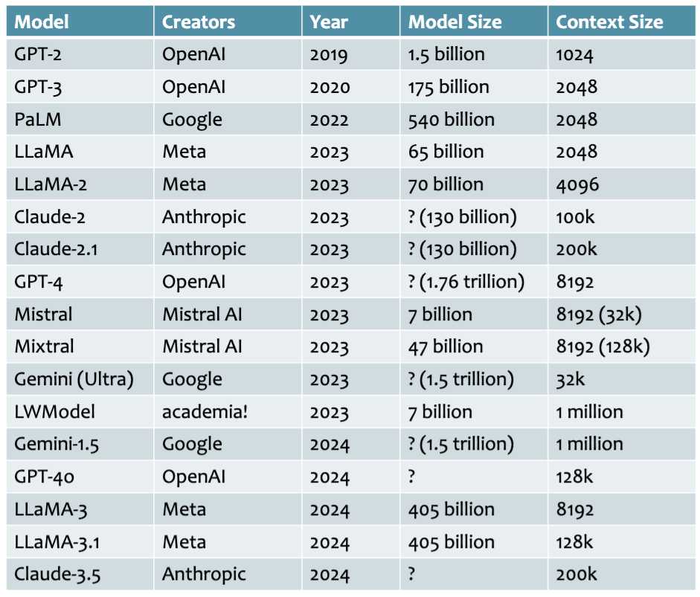
Nominal Context Lengths

Slide 9
Plan: Feeding Lots of Things to LM
Understanding Positional encodings
Length generalization of Transformer LMs
Retrieval-augmented generation
Chapter goal: Get familiar with techniques that are related and important for length generalization of LMs.

Slide 10
Revisiting Encoding Positional Information

Slide 11
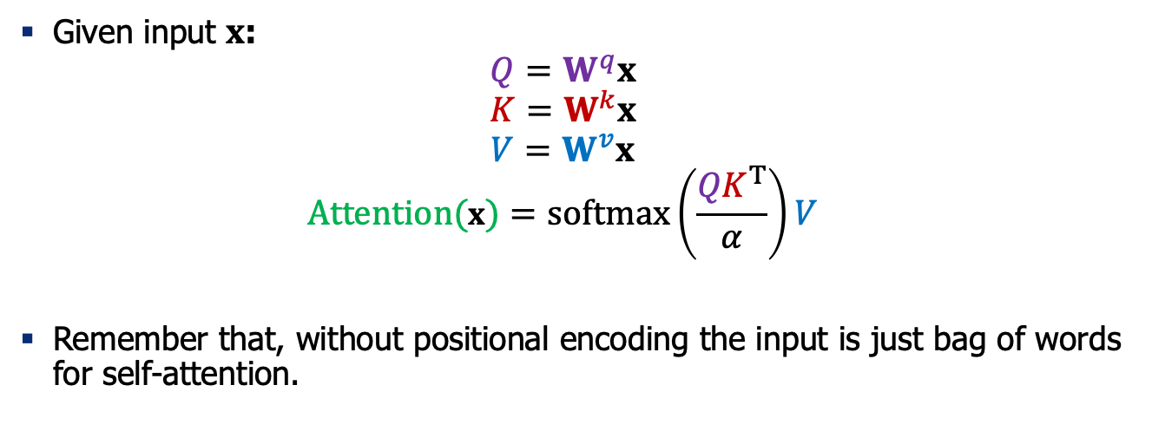
Recap: Self-Attention
Given input $x$:
$$Q=W^{q}x$$
$$K=W^{k}x$$
$$V=W^{v}x$$
$$Attention(x)=softmax\left(\frac{{QK}^{T}}{α}\right)V$$
Remember that, without positional encoding the input is just bag of words for self-attention.

Slide 12
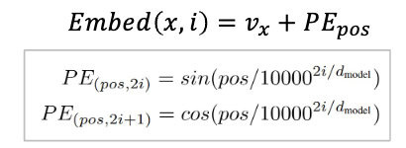
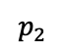
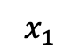
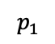
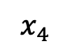
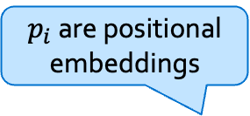
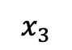
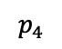
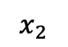
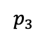
Positional Embeddings: The Flavors
Notable models:
Original Transformer
Sine embeddings: add sines and cosines that enable localization
O O
O O
O O
O O
O O
O O
O O
O O
O O
O O
O O
O O
Allows model to learn relative positioning
$p_{i}$ are positional embeddings
O O O O O
O O O O O
O O O O O
O O O O O
$$p_{1}$$
$$p_{2}$$
$$p_{3}$$
$$p_{4}$$
O O O O O
O O O O O
O O O O O
O O O O O
$$x_{1}$$
$$x_{2}$$
$$x_{3}$$
$$x_{4}$$

Slide 13
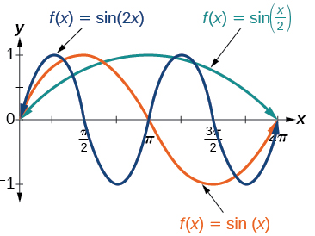
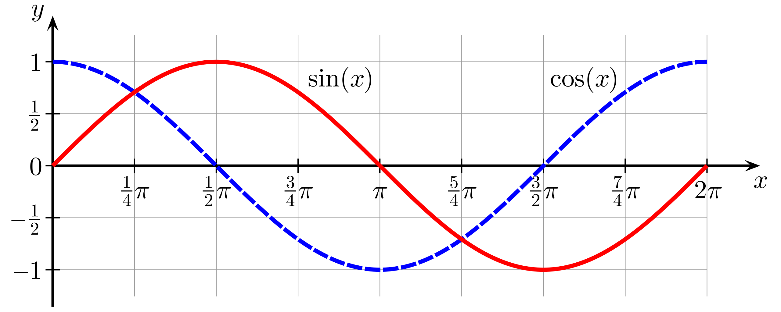
Math Recap: Sine and Cosine Functions

Slide 14
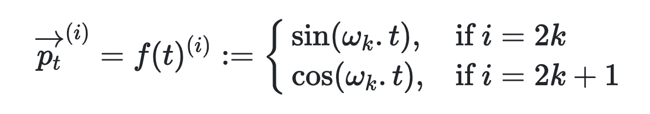
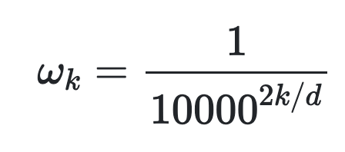
Absolute Positional Embeddings
Let t be a desired position. Then the i-th element of the positional vector is:
Here d is the maximum dimension.
This provides unique vectors for each position.
https://kazemnejad.com/blog/transformer_architecture_positional_encoding/

Slide 15
Quiz
Let t be a desired position:
Q: Are the frequencies increasing with dimension i ?
Answer: The frequencies are decreasing along the vector dimension.
https://kazemnejad.com/blog/transformer_architecture_positional_encoding/

Slide 16
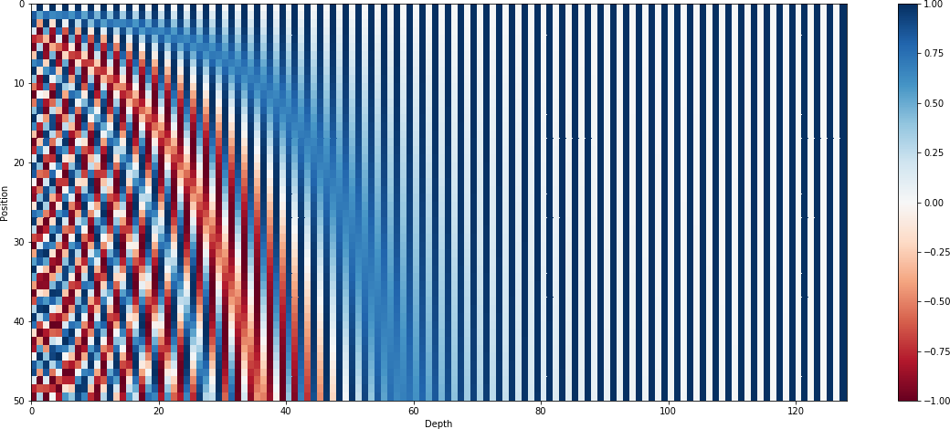
Visualizing Absolute Positional Embeddings
Here positions range from 0-50, for an embedding dimension of 130.

Slide 17
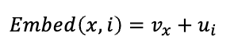
Positional Embeddings: The Flavors
Notable models:
Original Transformer
Sine embeddings: add sines and cosines that enable localization
Absolute embeddings: add a position vector to the embedding
Limitations:
We can have fixed encoding for each index training position (e.g., 1, 2, 3, … 1000).
What happens if we get a sequence with 5000 words at test time?
We want something that can generalize to arbitrary sequence lengths.
Notable models:
GPT1/2/3 - OPT

Slide 18
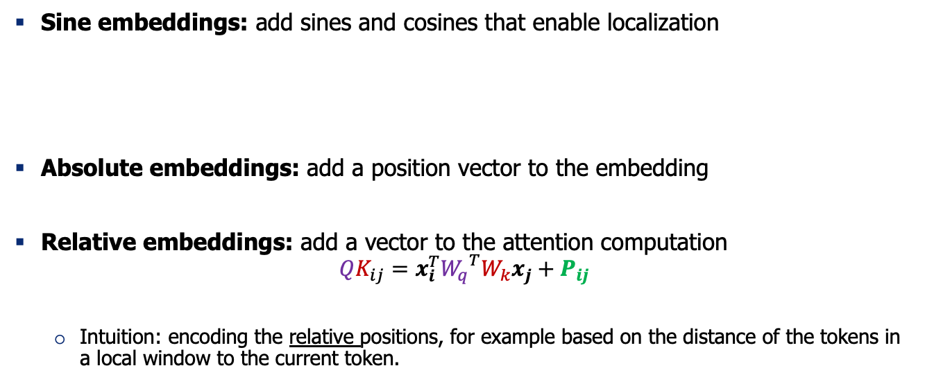
Positional Embeddings: The Flavors
Notable models:
Original Transformer
Sine embeddings: add sines and cosines that enable localization
Absolute embeddings: add a position vector to the embedding
Relative embeddings: add a vector to the attention computation
$$QK_{ij}=x_{i}^{T}{W_{q}}^{T}W_{k}x_{j}+P_{ij}$$
Intuition: encoding the relative positions, for example based on the distance of the tokens in a local window to the current token.
Notable models:
GPT1/2/3 - OPT
Notable models:
T5, Gopher, Chinchilla

Slide 19
Relative Positional Encoding: An Example
"I took the bus and then a cab after work"
position of "bus": 4;
position of "cab": 8
"During the last two weeks, when my car was in the shop for repair, I took the bus and then a cab after work."
position of "bus": 20;
position of "cab": 24
You want to a way of encoding the sentence so that the attention patterns depend on the relative distances.
[Example credit: Christian von der Weth]

Slide 20
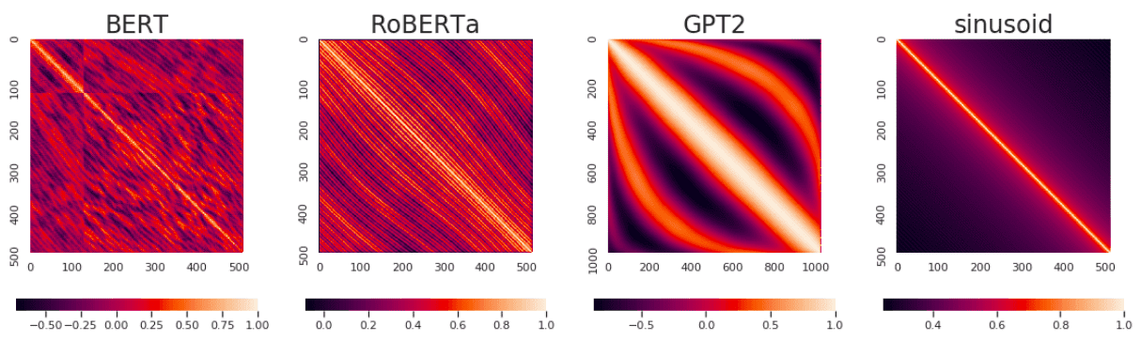
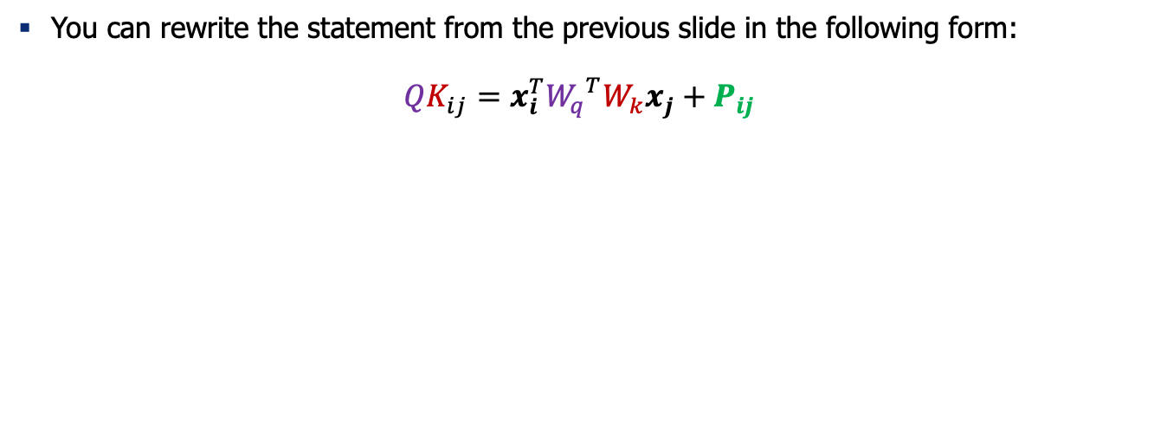
A Unified Perspective on Relative Positional Encoding
You can rewrite the statement from the previous slide in the following form:
$$QK_{ij}=x_{i}^{T}{W_{q}}^{T}W_{k}x_{j}+P_{ij}$$

Slide 21
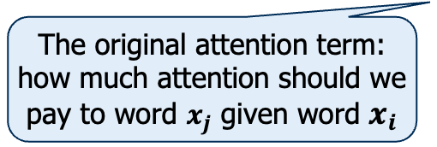
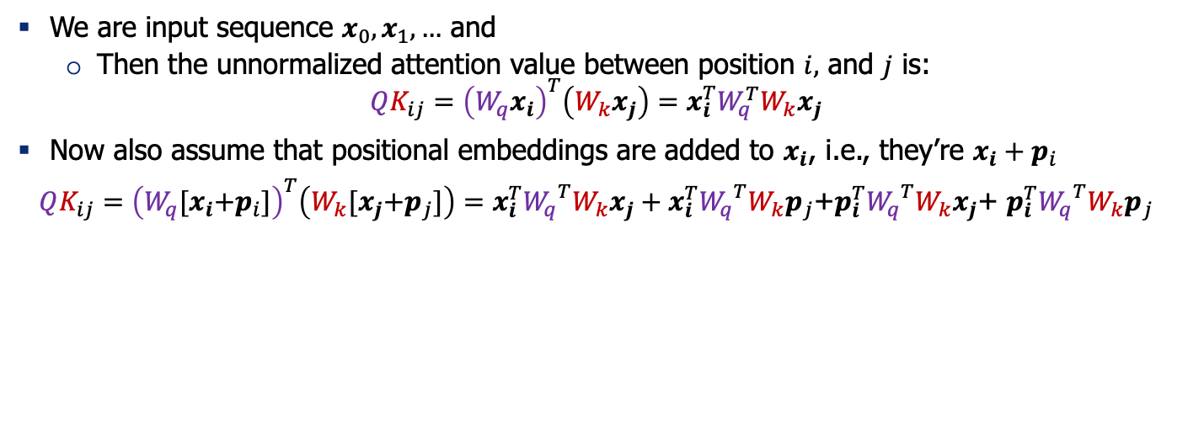
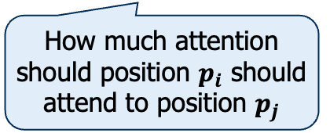
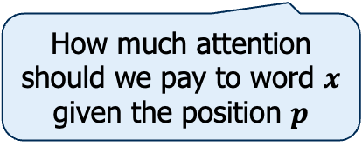
A Unified Perspective on Relative Positional Encoding
We are input sequence $x_{0},x_{1},…$ and
Then the unnormalized attention value between position $i,$ and $j$ is:
$${QK_{ij}=\left(W_{q}x_{i}\right)}^{T}\left(W_{k}x_{j}\right)=x_{i}^{T}W_{q}^{T}W_{k}x_{j}$$
Now also assume that positional embeddings are added to $x_{i}$, i.e., they’re $x_{i}+p_{i}$
${QK_{ij}=\left(W_{q}{[x}_{i}+p_{i}]\right)}^{T}\left(W_{k}{[x}_{j}+p_{j}]\right)=x_{i}^{T}{W_{q}}^{T}W_{k}x_{j}+x_{i}^{T}{W_{q}}^{T}W_{k}p_{j}$+$p_{i}^{T}{W_{q}}^{T}W_{k}x_{j}$+ $p_{i}^{T}{W_{q}}^{T}W_{k}p_{j}$
The original attention term: how much attention should we pay to word $x_{j}$ given word $x_{i}$
How much attention should we pay to word $x$ given the position $p$
How much attention should position $p_{i}$ should attend to position $p_{j}$

Slide 22
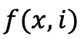
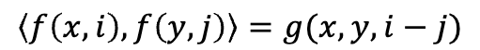
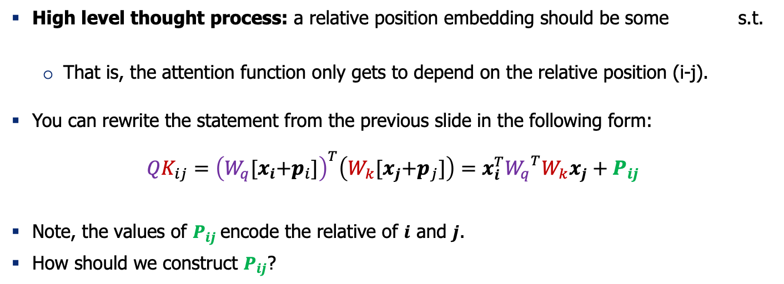
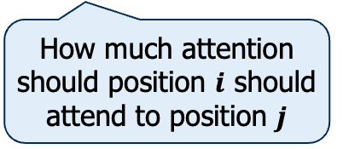
Relative Positional Encoding
High level thought process: a relative position embedding should be some s.t.
That is, the attention function only gets to depend on the relative position (i-j).
You can rewrite the statement from the previous slide in the following form:
$$QK_{ij}={\left(W_{q}{[x}_{i}+p_{i}]\right)}^{T}\left(W_{k}{[x}_{j}+p_{j}]\right)=x_{i}^{T}{W_{q}}^{T}W_{k}x_{j}+P_{ij}$$
Note, the values of $P_{ij}$encode the relative of $i$ and $j$.
How should we construct $P_{ij}$?
How much attention should position $i$ should attend to position $j$

Slide 23
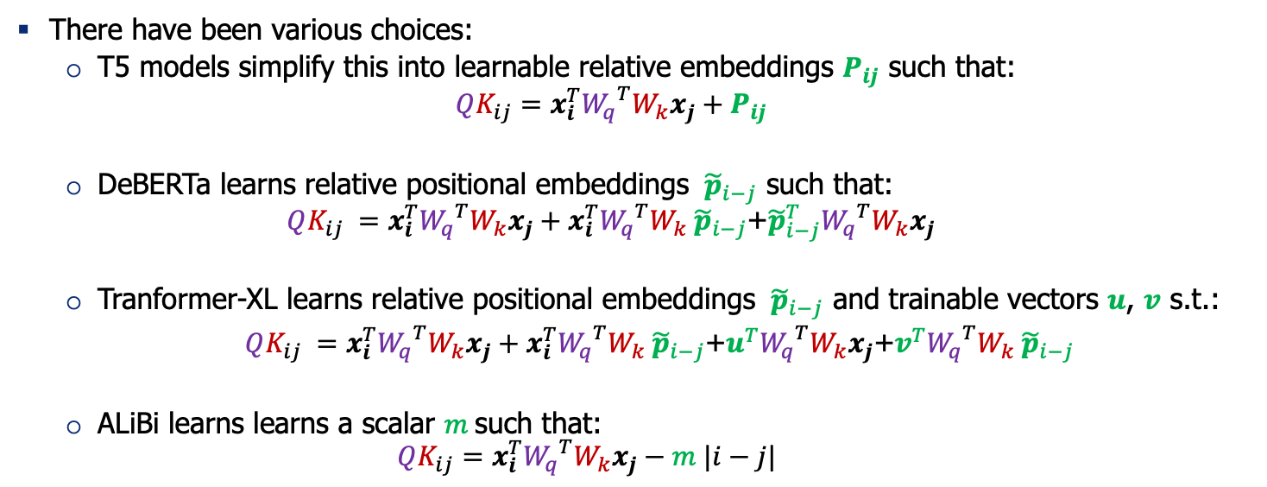
Relative Positional Encoding
There have been various choices:
T5 models simplify this into learnable relative embeddings $P_{ij}$ such that:
$$QK_{ij}=x_{i}^{T}{W_{q}}^{T}W_{k}x_{j}+P_{ij}$$
DeBERTa learns relative positional embeddings ${ \tilde{p}}_{i−j}$ such that:
$$QK_{ij} =x_{i}^{T}{W_{q}}^{T}W_{k}x_{j}+x_{i}^{T}{W_{q}}^{T}W_{k}{ \tilde{p}}_{i−j}\text{+}{\tilde{p}}_{i−j}^{T}{W_{q}}^{T}W_{k}x_{j}$$
Tranformer-XL learns relative positional embeddings ${ \tilde{p}}_{i−j}$ and trainable vectors $u$, $v$ s.t.:
$QK_{ij} =x_{i}^{T}{W_{q}}^{T}W_{k}x_{j}+x_{i}^{T}{W_{q}}^{T}W_{k}{ \tilde{p}}_{i−j}$+$u^{T}{W_{q}}^{T}W_{k}x_{j}$+$v^{T}{W_{q}}^{T}W_{k}{ \tilde{p}}_{i−j}$
ALiBi learns learns a scalar $m$such that:
$$QK_{ij}=x_{i}^{T}{W_{q}}^{T}W_{k}x_{j}−m |i−j|$$
Exploring the Limits of Transfer Learning with a Unified Text-to-Text Transformer, 2020
Train Short, Test Long: Attention with Linear Bia4s2es Enables Input Length Extrapolation (2022)

Slide 24
Recap
Notable models:
Original Transformer
Sine embeddings: add sines and cosines that enable localization
Absolute embeddings: add a position vector to the embedding
Relative embeddings: add a vector to the attention computation
RoPE embeddings: (forthcoming)
Notable models:
GPT1/2/3 - OPT
Notable models:
T5, Gopher, Chinchilla, Deberta Tranformer-XL,
Notable models:
GPTJ, PaLM, LLaMA, Gemma3, Qwen3, GPL, Apple models.

Slide 25
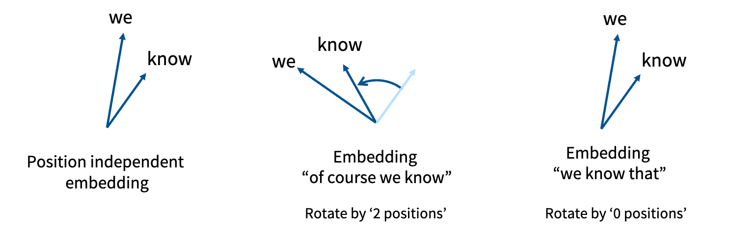
Rotary Positional Encoding (RoPE)
Bonus
We want our embeddings to be invariant to absolute position.
We know that inner products are invariant to arbitrary rotation.
[Slide credit: Tatsu Hashimoto]

Slide 26
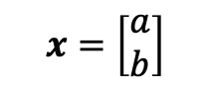
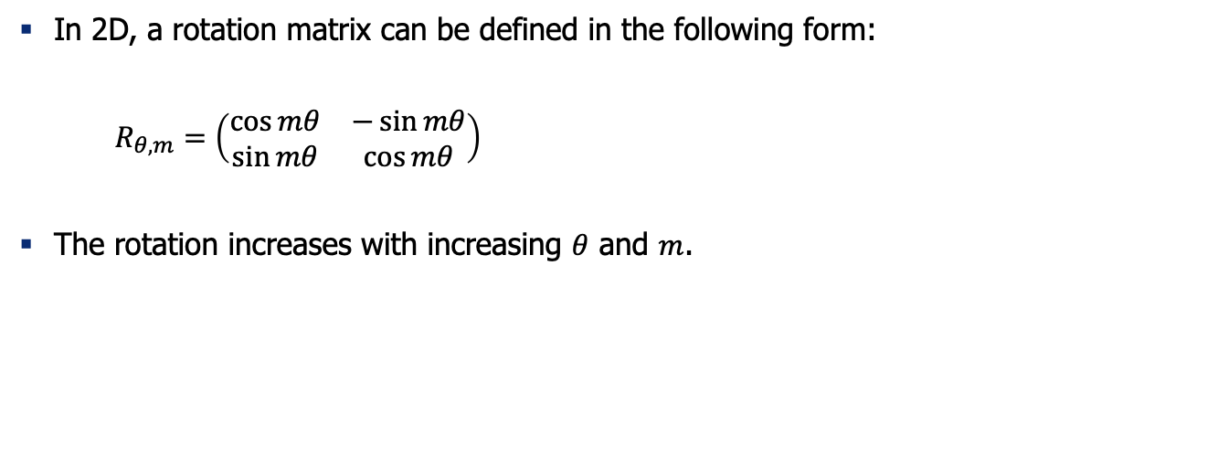
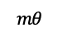

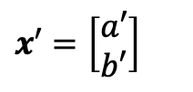
Thinking About Rotation Matrix
Bonus
In 2D, a rotation matrix can be defined in the following form:
$R_{θ, m}=\left(\begin{matrix}\cos{mθ} & −\sin{mθ} \\ \sin{mθ} & \cos{mθ}\end{matrix}\right)$
The rotation increases with increasing $θ$ and $m$.
$x′$ $=\left[\begin{matrix}a′ \\ b′\end{matrix}\right]$
$$x^{′}= R_{θ, m}x$$
$$mθ$$
$$x=\left[\begin{matrix}a \\ b\end{matrix}\right]$$

Slide 27
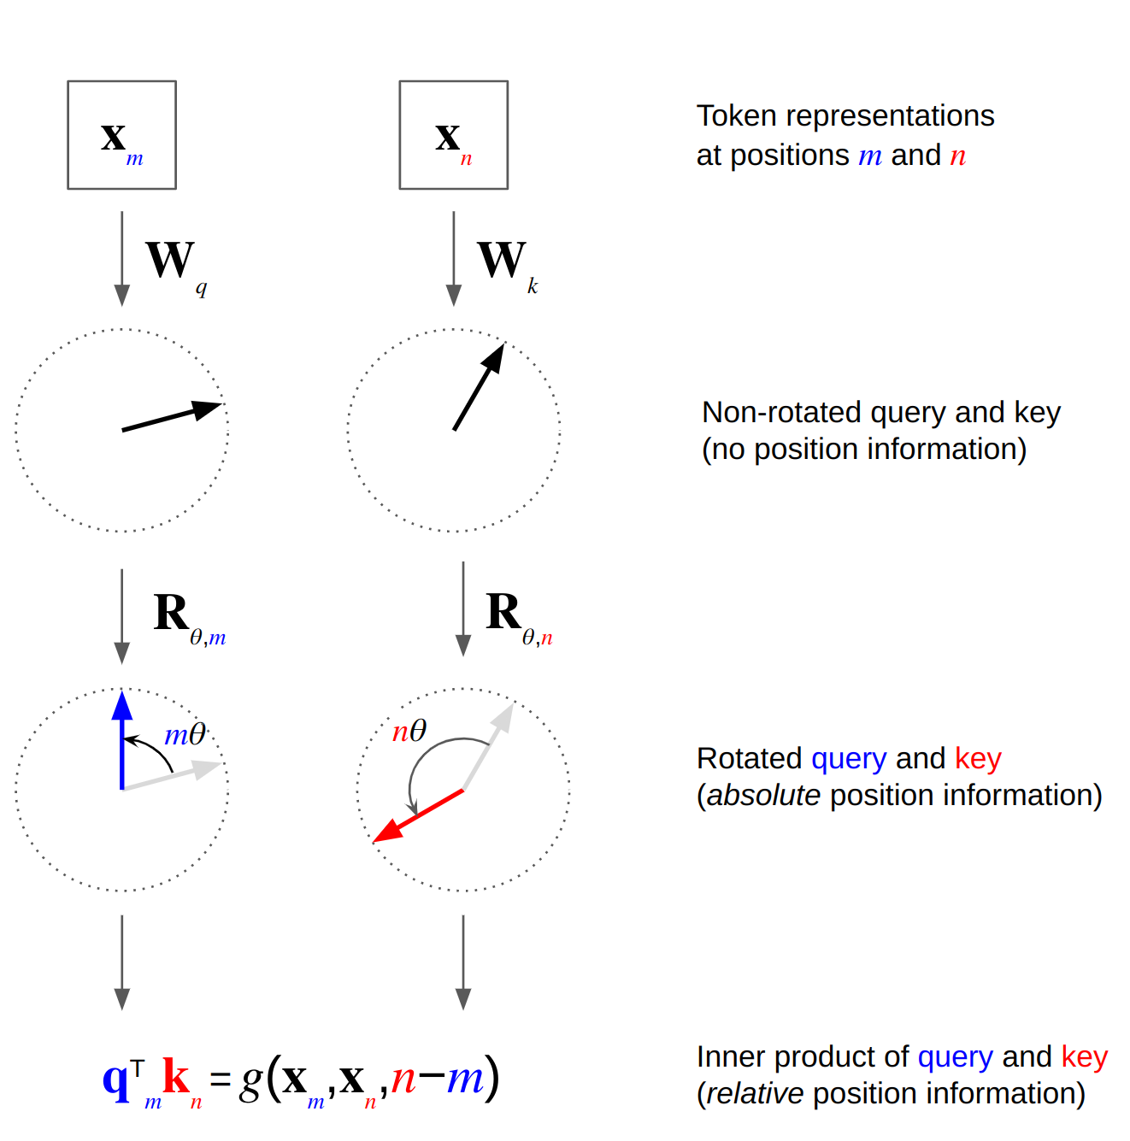
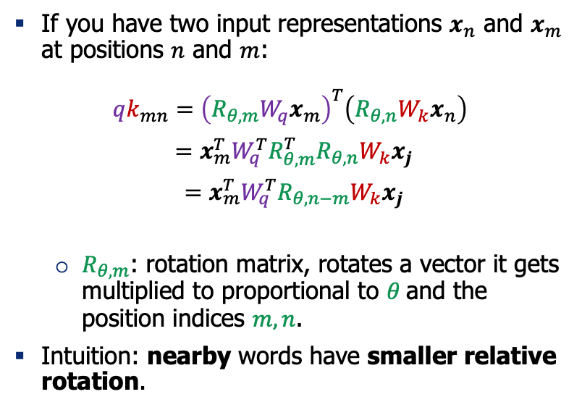
Rotary Positional Encoding (RoPE): 2D
Bonus
If you have two input representations $x_{n}$ and $x_{m}$ at positions $n$ and $m$:
$$qk_{mn}={\left(R_{θ, m}W_{q}x_{m}\right)}^{T}\left(R_{θ, n}W_{k}x_{n}\right)$$
$=x_{m}^{T}W_{q}^{T}R_{θ, m}^{T}R_{θ, n}W_{k}x_{j}$
$=x_{m}^{T}W_{q}^{T}R_{θ, n−m}W_{k}x_{j}$
$R_{θ, m}$: rotation matrix, rotates a vector it gets multiplied to proportional to $θ$and the position indices $m,n$.
Intuition: nearby words have smaller relative rotation.
RoFormer: Enhanced Transformer with Rotary Position Embedding (2022)
Figure source

Slide 28
Thinking d Dimensions
Bonus
Create pairs of coordinates that would rotate together
Each pair can have a different frequency of rotations

Slide 29
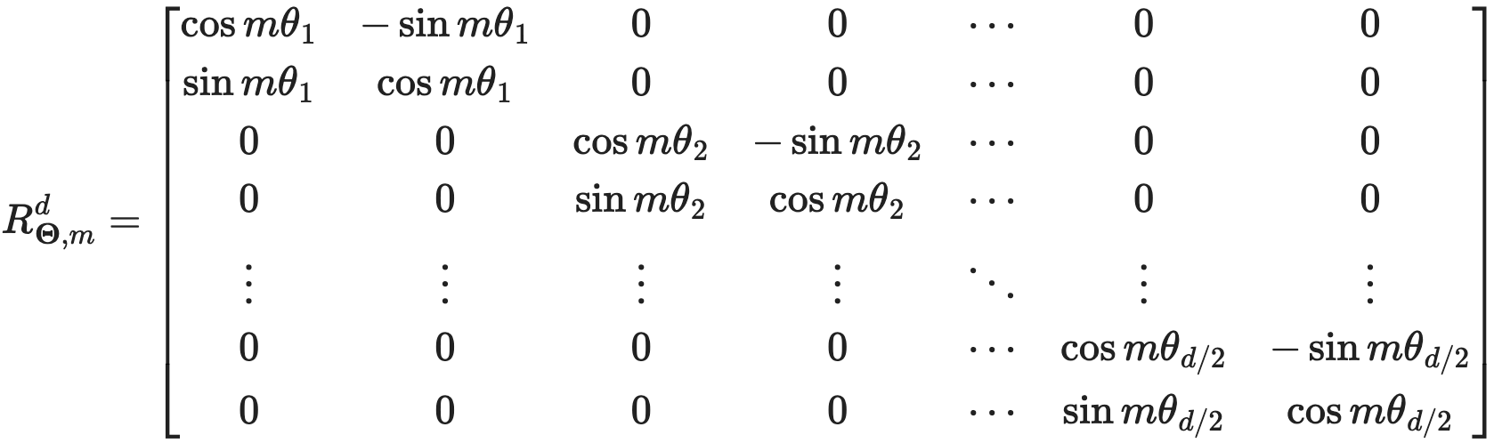
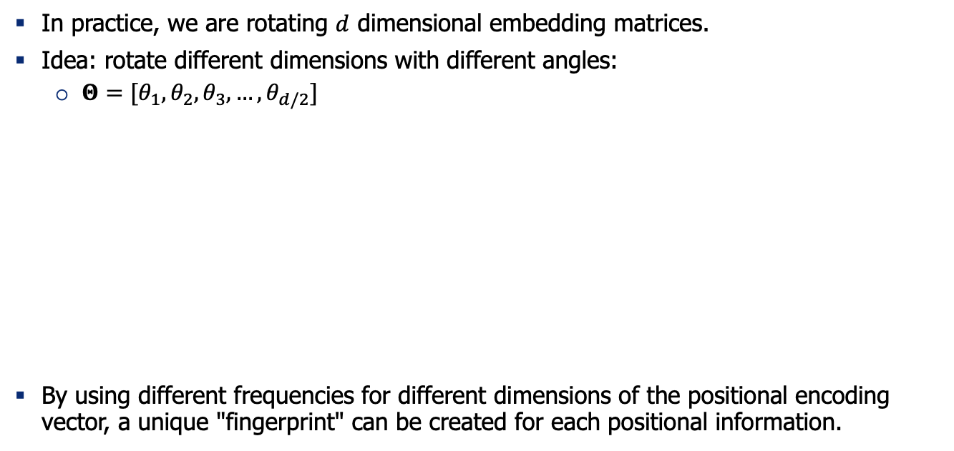
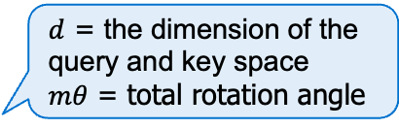
Thinking d Dimensions
Bonus
In practice, we are rotating $d$ dimensional embedding matrices.
Idea: rotate different dimensions with different angles:
$Θ=[θ_{1},θ_{2},θ_{3},…, θ_{d/2}]$
By using different frequencies for different dimensions of the positional encoding vector, a unique "fingerprint" can be created for each positional information.
$d$ = the dimension of the query and key space
$mθ$ = total rotation angle

Slide 30
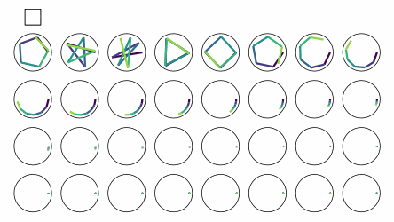
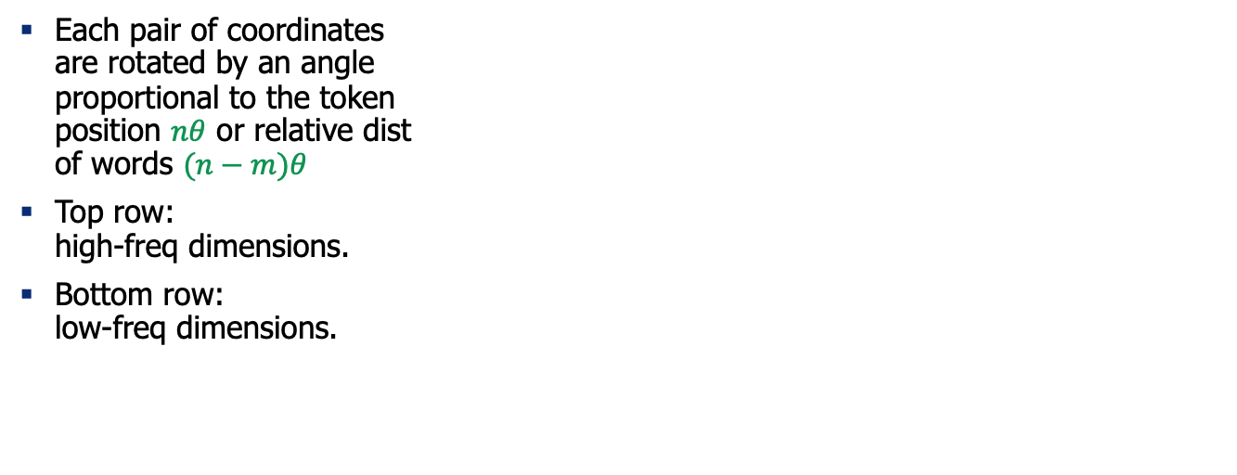
RoPE, visualized.
$$(n−m)θ$$
Each pair of coordinates are rotated by an angle proportional to the token position $nθ$ or relative dist of words $(n−m)θ$
Top row: high-freq dimensions.
Bottom row: low-freq dimensions.
Visualization by Sasha Rush: https://colab.research.google.com/drive/1JhVaH1Tr6BMLKX9mgIjN83qFh9DOOyvC?usp=sharing#scrollTo=xeBojFzJRfu1

Slide 31
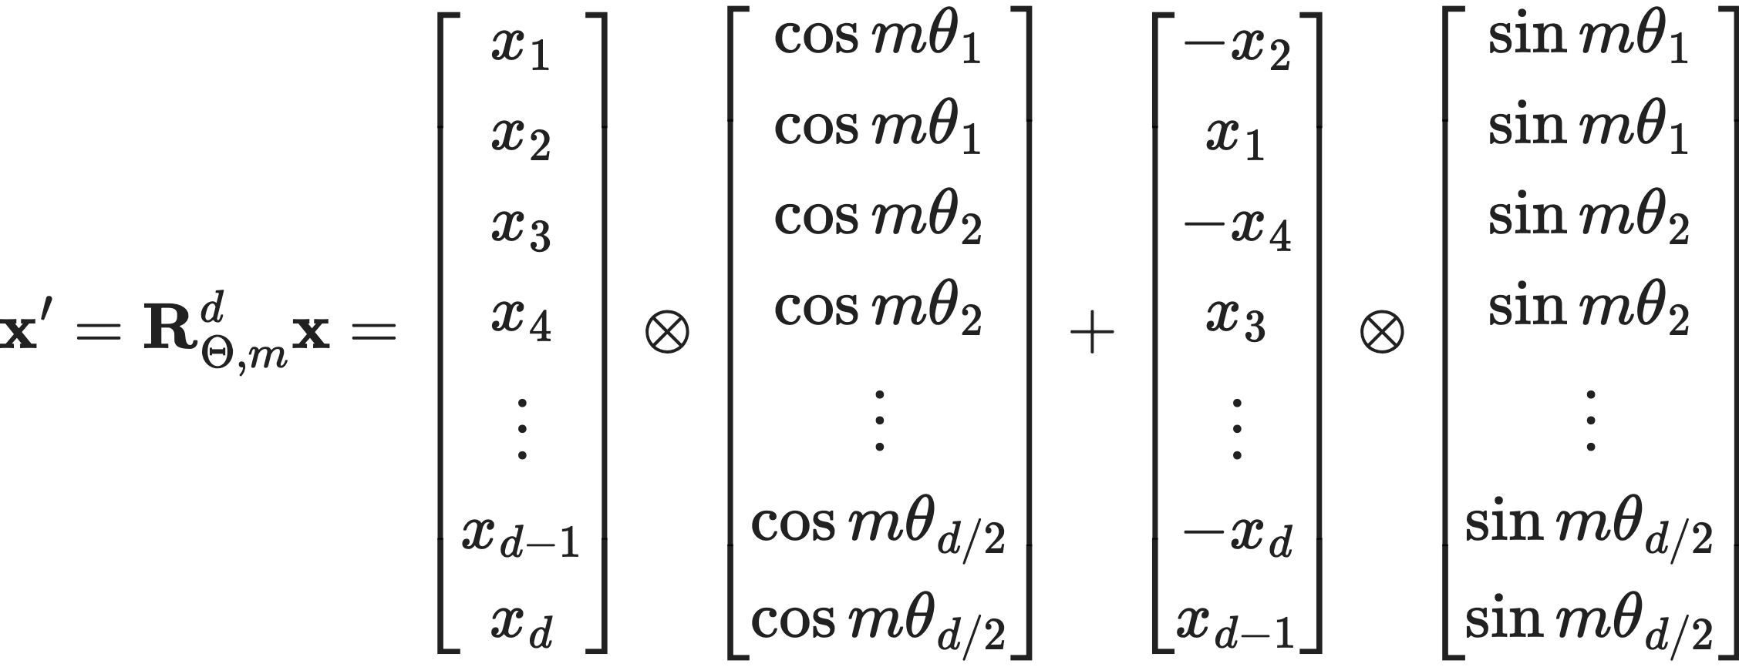
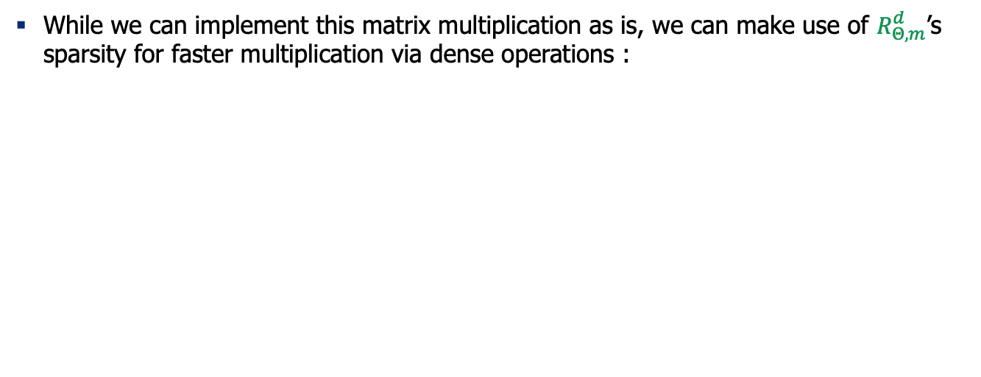
RoPE via Faster (Dense) Operations
Bonus
While we can implement this matrix multiplication as is, we can make use of $R_{Θ, m}^{d}$’s sparsity for faster multiplication via dense operations :

Slide 32
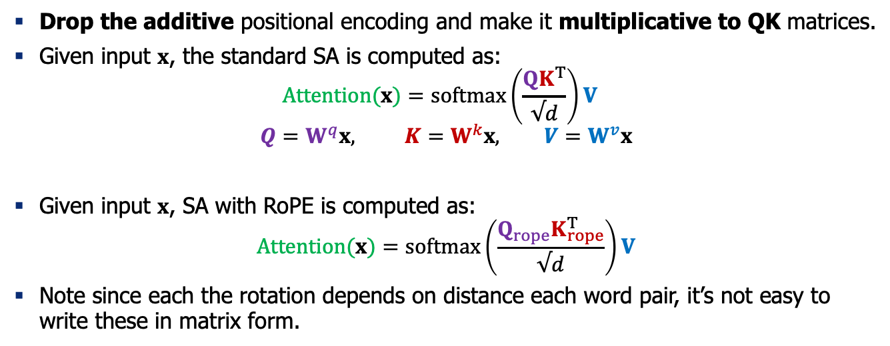
Integrating RoPE to Self-Attention
Drop the additive positional encoding and make it multiplicative to QK matrices.
Given input $x$, the standard SA is computed as:
$$Attention(x)=softmax\left(\frac{{QK}^{T}}{√d}\right)V$$
$$Q=W^{q}x, K=W^{k}x, V=W^{v}x$$
Given input $x$, SA with RoPE is computed as:
$$Attention(x)=softmax\left(\frac{{Q_{rope}K}_{rope}^{T}}{√d}\right)V$$
Note since each the rotation depends on distance each word pair, it’s not easy to write these in matrix form.

Slide 33
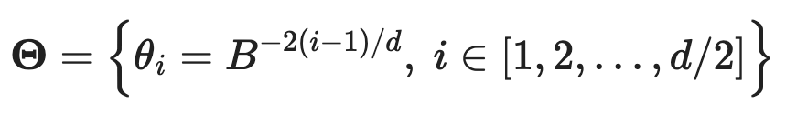
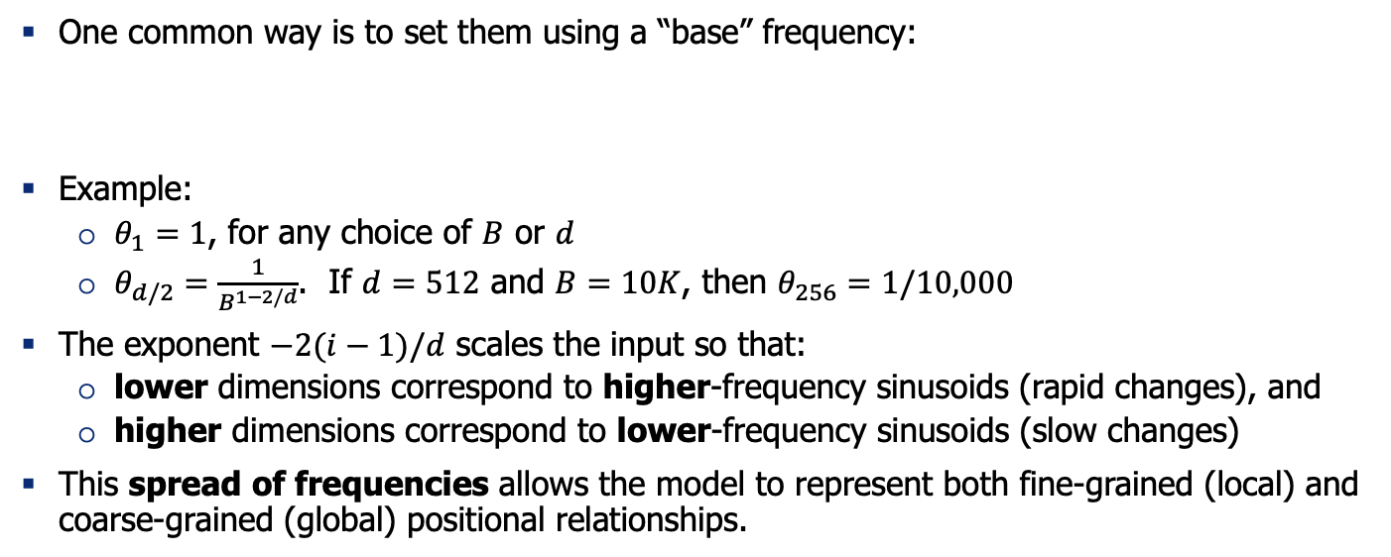

Setting $Θ=[θ_{1},θ_{2},θ_{3},…, θ_{d/2}]$
One common way is to set them using a “base” frequency:
Example:
$θ_{1}=1$, for any choice of $B$ or $d$
$θ_{d/2}=\frac{1}{B^{1−2/d}}$. If $d=512$ and $B=10K$, then $θ_{256}=1/10,000$
The exponent $−2(i−1)/d$ scales the input so that:
lower dimensions correspond to higher-frequency sinusoids (rapid changes), and
higher dimensions correspond to lower-frequency sinusoids (slow changes)
This spread of frequencies allows the model to represent both fine-grained (local) and coarse-grained (global) positional relationships.

Slide 34

Q: How should we set the “base” freq?
You want the largest wavelength (lowest freq) be close to your longest context dist.
Lowest frequency: $θ_{d/2}=\frac{1}{B^{1−2/d}} ⇒$ The largest wavelength: $T_{max}=\frac{2π}{θ_{d/2}}≈2πB$
Examples:
If $B=10,000⇒ T_{max}≈62K$ tokens
If $B=100,000⇒ T_{max}≈628K$ tokens
In both original RoPE paper (and the original Transformer paper), $B=10,000$.

Slide 35

Examples of Base Frequencies
Llama3 positional encoding: RoPE (θ = 500,000)
Gemma3 positional encoding: A mix of RoPE (θ = 1,000,000) + RoPE (θ = 10,000)
Llama3 tech report: https://arxiv.org/pdf/2407.21783
Gemma3 tech report: https://arxiv.org/abs/2503.19786

Slide 36

Fixed Window Attending to Long-Context
Imagine you have a Self-Attention limited to a window of size 4.
Transformer-XL: Attentive Language Models Beyond a Fixed-Length Context, 2020

Slide 37
Fixed Window Attending to Long-Context
Imagine you have a Self-Attention limited to a window of size 4.
Transformer-XL: Attentive Language Models Beyond a Fixed-Length Context, 2020

Slide 38
Fixed Window Attending to Long-Context
Imagine you have a Self-Attention limited to a window of size 4.
Transformer-XL: Attentive Language Models Beyond a Fixed-Length Context, 2020

Slide 39

Positional Encodings May Not be Necessary!!
Some result suggest that, you might be able to build low-ppl LMs even if you drop the positional embeddings.
Notice that these results are for causal (decoder) Transformer architectures.
Now the questions are:
How can Transformers do language modeling without positional embeddings?
Does low PPL for language modeling entail being good for any language ability? (e.g., ICL)
Transformer Language Models without Positional Encodings Still Learn Positional Information, 2022

Slide 40

Encoding Positions without Encoding it
One explanation is that decoder Transformers implicitly encoder positional information in variances of attention values.
Attention values of position m result from combining the information of m positions. If the input values are samples from Gaussian distribution, the variance of output values scale with 1/m.
In practice, the earlier layers follow this pattern. But still variance encodes positions.
Latent Positional Information is in the Self-Attention Variance of Transformer Language Models Without Positional Embeddings, 2023

Slide 41
Summary
Encoding positional information in language models is a non-trivial problem.
We discussed various proposal: learned, absolute, relative encoding, NoPos, etc.
This is an important literature related to the length generalization of Transformers.
This is an active research area and likely to change in the coming years.

Slide 42
Long Context Generalization

Slide 43

Needle-in-Haystack Problems
You’re given k documents in the input.
(e.g., the retrieval results)
One of these docs may contain the answer to a given query which we want to answer.

Slide 44

https://github.com/gkamradt/LLMTest_NeedleInAHaystack

Slide 45

Recency vs Primacy bias

Slide 46

Recent vs Primacy Bias: Size of “Gold” doc
Hidden in the Haystack: Smaller Needles are More Difficult for LLMs to Find

Slide 47
Length Generalization
Q: if you train the model up to length l, would it generalize to >l?

Slide 48

Length Generalization
The Impact of Positional Encoding on Length Generalization in Transformers, 2023

Slide 49

Length Generalization
The Impact of Positional Encoding on Length Generalization in Transformers, 2023

Slide 50

Why Transformers Fail to Generalize?
Unseen distances between tokens cause attention logits to explode
Attention distribution becomes less informative (high entropy).
LM-Infinite: Zero-Shot Extreme Length Generalization for Large Language Models, 2023

Slide 51
Long Context Extensions

Slide 52

Context Extension: Challenges
You’re given a transformer trained on a default length.
Now we want to extend its length.
Chen et. al, 2023, Extending Context Window of Large Language Models via Positional Interpolation

Slide 53

Context Extension: Challenges
Challenge 1: Adapting the positional encodings
Challenge 2: Efficiency challenge since the FLOP/memory footprint grows quadratically.
Challenge 3: Long data is very limited.
Chen et. al, 2023, Extending Context Window of Large Language Models via Positional Interpolation

Slide 54
Context Extension during Pre-training
Two ingredients:
Extensible positional encoding
Carefully selected long training data
Recipe:
Pre-train a short context model(block size = 4k) on 1 trillion tokens of text
Adjust the hyperparameters of the positional embeddings
Continue pre-training but increase the block size to support long-contexts (block size = 80k). This may involve training on a smaller amount of data.

Slide 55





Approach: Changing ROPE Frequencies
Assuming that we use RoPE encoding, reduce the base frequency by $α$ so that more tokens fit within each period.
$$→$$

Slide 56

Uniform Scaling
Linear Position Interpolation (PI):
Scale all frequencies by the same scale:
$α_{j}^{PI}=\frac{C}{C^{′}}=\frac{1}{t}$
This lowers every frequency uniformly so more tokens fit in each sinusoidal period.

Slide 57

NTK Scaling
$$α_{j}=κ^{−\frac{2j}{d_{k}}}, j=1, …,\frac{d_{k}}{2}$$
High frequencies scaled down less (~preserved)
Low frequencies are shrunk more (matching PI extension)
Why is it called ”NTK”?
Neural Tangent Theory is this idea that, high-frequency information are hard to learn.
So, it’s better to not mess with them! (i.e., scale high-frequencies minimally)

Slide 58



YaRN Scaling
Basically, piecewise scaling across dimensions.
Context length ratio: $t=C^{′}/C$
Temperature parameter: $T$ to reduce all freq uniformly, if needed.
Interpolation gate for dimension $j$ : $γ_{j}$
Hyperparameters: $p$, $q$, $T$ which can be tuned as needed.
Modes:
Low-frequency dimensions ($θ_{j}<p$): fully PI-scaled ($1/t$).
High-frequency dimensions ($θ_{j}>q$): no scaling (kept as original RoPE) if T=1.
Middle band ($q<θ_{j}<p$): smoothly interpolated.

Slide 59

Empirical Comparison of RoPE extensions
Base model: llama2-7B which has a context of window of ~4k tokens.
Goal: extending the context window from 4k to 32k
A Controlled Study on Long Context Extension and Generalization in LLMs, 2025

Slide 60

X-axis shows length of the input.
Y-axis shows where the “needle” was included in the context (first row: needle in the beginning)
The white dashed line denotes the longest length examples seen at training or finetuning
A Controlled Study on Long Context Extension and Generalization in LLMs, 2025

Slide 61

X-axis shows length of the input.
Y-axis shows where the “needle” was included in the context (first row: needle in the beginning)
The white dashed line denotes the longest length examples seen at training or finetuning
A Controlled Study on Long Context Extension and Generalization in LLMs, 2025

Slide 62

Y-axis shows perplexity.
The base model is trained up to 4k tokens. .
The extensions are trained on data up to 32k.
Note some generalize to 64k.
A Controlled Study on Long Context Extension and Generalization in LLMs, 2025

Slide 63
Model | Positional enc | Pre-training extension | Post-training extension
Qwen 3 | RoPE | Increased base freq from 10K to 1M; used YaRN. Also uses Dual Chunk Attention. | Training on a dataset of long Chain-of-Thoughts.
Apple | RoPE (local attention) and no encoding for global attention | Trained on seq up to 65K tokens sampled from “natural” data e.g., licensed books, code repos, synthetic long-form data. | ??
GLM | RoPE | Trained on 4K data (base=10K). Then did more training up to 128K (base=1M). Up-sample long documents from the pre-training corpus. | SFT with long reasoning traces (up to 128K)
Gemma3 | RoPE | Pre-train on 32K seq (base=10K) and scale to 128K toward the end of training (base=1M). | ??
Lamma3 | RoPE | Pre-train on shorter sequences (base=500K) and then extend to 128K tokens. | SFT on some (0.1%) long data
Qwen3 Technical Report, Apple Intelligence Foundation Language Models, GLM-4.5: Agentic, Reasoning, and Coding (ARC) Foundation Models, Gemma3 tech report

Slide 64

Examples in the wild: Qwen3
Qwen2.5-7B-Instruct-1M
Changing RoPE base frequency (to stretch positional embeddings further).
Training recipe to gradually expose the model to longer contexts.
Qwen2.5-1M Technical Report, 2025

Slide 65

Examples in the wild: Gemma3
“Instead of training with 128K sequences from scratch, we pre-train our models with 32K sequences and then scale the 4B, 12B, and 27B models up to 128K tokens at the end of pre-training while rescaling RoPE”
“Our models generalize to 128K, but rapidly degrade as we continue to scale.”
Gemma3 tech report: https://arxiv.org/abs/2503.19786

Slide 66

Examples in the wild: GLM-4.5
We set the maximum sequence length to 4,096 during pre-training, and extended it to 32,768 and 131,072 during the mid-training stage … When extending the sequence length to 32K, we also adjusted RoPE’s base frequency from 10,000 to 1,000,000 for better long-context modeling ability.”
Gemma3 tech report: https://arxiv.org/abs/2503.19786

Slide 67

Examples in the wild: Lamma3
Qwen2.5-1M Technical Report, 2025

Slide 68
Summary
RoPE the dominant positional encoding.
People usually train short and extend longer.

Slide 69
Long Context: Efficiency Considerations

Slide 70

Transformer LMs and Long Inputs
Length generalization: Do Transformers work accurately on long inputs?
Efficiency considerations: How efficient are LMs are long inputs?

Slide 71


Sparse Attention Patterns
The idea is to make the attention operation sparse
[NAACL 2021 Tutorial Beltagy, Cohan, Hajishirzi, Min, and Peters]

Slide 72
Sparse Attention Patterns: Challenge
Ok sparsity is great, but how to efﬁciently implement this?
Challenge: Arbitrary sparse matrix multiplication is not supported in DL libraries
A solution: Perform computations in blocks
[NAACL 2021 Tutorial Beltagy, Cohan, Hajishirzi, Min, and Peters]

Slide 73

Pre-speciﬁed Sparsity Patterns: Computations
Efﬁcient blockiﬁed implementation
There are libraries for implementing blockified sparse matrix multiplication.
Can be hardware speciﬁc
Block Sparse (Gray et al., 2017)
TVM toolkit (Chen et al., 2018)
cuSPARSE
[Big Bird (Zaheer et al., 2020)]

Slide 74
Sparse Patterns
How to sparsify?
Content-based
Routing Transformers (Roy et al., 2019)
Sinkhorn (Tay et al., 2020)
Reformer (Kitaev et al., 2020)
Pre-speciﬁed patterns
Sparse Transformer (Child et al,. 2019)
Longformer (Beltagy, et al., 2020)
ETC (Ainslie et al., 2020)
BigBird (Zaheer et al., 2020)
[NAACL 2021 Tutorial Beltagy, Cohan, Hajishirzi, Min, and Peters]

Slide 75


Content-Based Patterns
Routing Transformer (Roy et al., 2020)
Clustering-based attention mechanism that learns the attention sparsity in a data driven fashion.
Project Q and K into routing matrix R
The R matrix undergoes k-means clustering
After clustering, each token only attends to tokens from the same cluster
Auto-regressive attention, each color shows cluster membership
[NAACL 2021 Tutorial Beltagy, Cohan, Hajishirzi, Min, and Peters]

Slide 76





Pre-speciﬁed Sparsity Patterns
A variety of patterns has been explored in the past work
Longformer (Beltagy et al., 2020), Sparse Transformer (Child et al., 2019), …
Sliding window
Dilated
Global
Blocked
Random
Sparse Transformer Longformer
Longformer
Big Bird
Big Bird Sinkhorn
Big Bird
[NAACL 2021 Tutorial Beltagy, Cohan, Hajishirzi, Min, and Peters]

Slide 77

Pre-speciﬁed Sparsity Patterns
Different layers and attention heads can follow different patterns
A common setup is to have earlier layers with sparser attention pattern.
Longformer (Beltagy et al., 2020)

Slide 78

Pre-speciﬁed Sparsity Patterns: Computations
[Longformer (Beltagy et al., 2020)]

Slide 79

A Notable Adoption: GPT-3
Sparse patterns also used in GPT-3 (Brown et al., 2020)

Slide 80
Summary
How well do Transformers work on long sequences? Not so well.
How can we make them more efficient? Induce sparsity.
Many open questions we did not get into:
Limitations of sportifying Transformers
Alternatives to Transformers (e.g., state-space models)
…

Slide 81
Retrieval-Augmented LMs

Slide 82


Retrieval-based Language Models
It is a language model
P(x_{n} | x₁, x₂, ⋯, x_{n−1})
The capital city of Ontario is
(can be broadly extended to masked language models or encoder-decoder models)
It retrieves from an external datastore (at least during inference time)
(Also referred to semiparametric and non-parametric models)
[Slides: Akari Asai, Sewon Min, Zexuan Zhong, Danqi Chen]

Slide 83





Why retrieval-based LMs?
LLMs can’t memorize all (long-tail) knowledge in their parameters
List 5 important papers authored by Geoffrey Hinton
What is Kathy Saltzman’s occupation?
Geoffrey Hinton is a renowned computer scientist … Here are five important papers authored by him:
"Learning Internal Representations by Error Propagation" (with D. E. Rumelhart and R. J. Williams) - This paper, published in 1986, ..
"Deep Boltzmann Machines" (with R.
Salakhutdinov) - Published in 2009, ..
…
"Deep Learning" (with Y. Bengio and A. Courville) - Published as a book in 2016,…
"Attention Is All You Need" (with V. Vaswani, N. Shazeer, et al.) - Published in 2017, this paper introduced the Transformer model,…
(Mallen et al., 2023)
GPT-3 davinci-003: 20%-30% accuracy
[Slides: Akari Asai, Sewon Min, Zexuan Zhong, Danqi Chen]

Slide 84


Why retrieval-based LMs?
LLMs’ knowledge is easily outdated and hard to update
Who is the CEO of Twitter?
As of my knowledge cutoff in September 2021, the CEO of Twitter is Jack Dorsey….
Existing knowledge editing methods are still NOT scalable (active research!)
The datastore can be easily updated and
expanded - even without retraining!
New!
[Slides: Akari Asai, Sewon Min, Zexuan Zhong, Danqi Chen]

Slide 85




Why retrieval-based LMs?
LLMs’ output is challenging to interpret and verify
[Slides: Akari Asai, Sewon Min, Zexuan Zhong, Danqi Chen]

Slide 86


Why retrieval-based LMs?
LLMs are *large* and expensive to train and run
LM
vs.
Long-term goal: can we possibly reduce the training and
inference costs, and scale down the size of LLMs?
e.g., RETRO (Borgeaud et al., 2021): “obtains comparable performance to GPT-3 on the Pile, despite using 25x fewer parameters”
[Slides: Akari Asai, Sewon Min, Zexuan Zhong, Danqi Chen]

Slide 87
What are the Key Design Questions?
What are your memories?
Documents, database records, training examples, etc.
How to retrieve memories?
Use an off-the-shelf search engine (e.g. Google, StackOverflow).
How to train your own memory retriever.
How to use retrieved memories?
"Text fusion"
Common failure modes:
Underutilization: model ignores retrieved memories.
Overreliance: model depends too much on memories!
[Slides: Kelvin Guu]

Slide 88
Anatomy of a Neural Retriever
Score the input against each key.
Return the value for the highest scoring key.
key
value
1.2
key
value
0.3
input
6.8
key
value
7.1
key
value
A similarity function: sim(input, key) → score
[Slides: Kelvin Guu]

Slide 89

Finding Nearest Neighbors
[Slides: Yusuke Matsui]

Slide 90

Approximate Finding Nearest Neighbors
[Slides: Yusuke Matsui]

Slide 91

Approximate NNs: Algorithms, Libraries, Services
More information: https://github.com/facebookresearch/faiss/wiki
Space partitioning + data compression
[Slides: Martin Aumüller]

Slide 92
Approximate NNs: Algorithms, Libraries, Services
Algorithm
Scientific paper
Math
Often, by researchers
Library
Implementations of algorithms
Usually, a search function only
By researchers, developers, etc
faiss
NMSLIB
hnswlib
ScaNN
Service (e.g., vector DB)
Library + (handling metadata,
serving, scaling, IO, CRUD, etc)
Usually, by companies
Product Quantization + Inverted Index (PQ, IVFPQ) [Jégou+, TPAMI 2011]
Pinecone
Qdrant
Hierarchical Navigable Small World (HNSW) [Malkov+, TPAMI 2019]
Milvus
jina
Vald
Vertex AI Matching Engine
ScaNN (4-bit PQ)
[Guo+, ICML 2020]
Weaviate
29
[Slides: Yusuke Matsui]

Slide 93
Three levels of technology
Algorithm Library Service (e.g., vector DB)
➢ Scientific paper ➢ Implementations of algorithms ➢ Library + (handling metadata,
➢ Math ➢ Usually, a search function only serving, scaling, IO, CRUD, etc)
➢ Often, by researchers ➢ By researchers, developers, etc ➢ Usually, by companies
Pinecone
Qdrant
Milvus
NMSLIB jina
^{Vald} Vertex AI
_{ScaNN (4-bit PQ)} ^{hnswlib} Matching Engine
[Guo+, ICML 2020]
ScaNN Weaviate
30
Product Quantization + Inverted Index (PQ, IVFPQ) [Jégou+, TPAMI 2011]
faiss
Hierarchical Navigable Small World (HNSW) [Malkov+, TPAMI 2019]
One library may implement
multiple algorithms
☹ “I benchmarked faiss”
☺ “I benchmarked PQ in faiss”
[Slides: Yusuke Matsui]

Slide 94
One algorithm may be
Three levels of technology
Algorithm Library Service (e.g., vector DB)
➢ Scientific paper ➢ Implementations of algorithms ➢ Library + (handling metadata,
➢ Math ➢ Usually, a search function only serving, scaling, IO, CRUD, etc)
➢ Often, by researchers ➢ By researchers, developers, etc ➢ Usually, by companies
Product Quantization + _{Pinecone}
Inverted Index (PQ, IVFPQ)
[Jégou+, TPAMI 2011]
Qdrant
Milvus
jina
^{Vald} Vertex AI
_{ScaNN (4-bit PQ)} Matching Engine
[Guo+, ICML 2020]
ScaNN Weaviate
31
implemented in multiple libraries
faiss
Hierarchical Navigable Small World (HNSW) [Malkov+, TPAMI 2019]
NMSLIB
hnswlib
[Slides: Yusuke Matsui]

Slide 95
One service may use some libraries
Three levels of technology
Algorithm Library Service (e.g., vector DB)
➢ Scientific paper ➢ Implementations of algorithms ➢ Library + (handling metadata,
➢ Math ➢ Usually, a search function only serving, scaling, IO, CRUD, etc)
➢ Often, by researchers ➢ By researchers, developers, etc ➢ Usually, by companies
Product Quantization + _{Pinecone}
Inverted Index (PQ, IVFPQ)
[Jégou+, TPAMI 2011]
Qdrant
NMSLIB jina
^{Vald} Vertex AI
_{ScaNN (4-bit PQ)} Matching Engine
[Guo+, ICML 2020]
ScaNN
33
faiss
Hierarchical Navigable Small World (HNSW) [Malkov+, TPAMI 2019]
Milvus
hnswlib
… or re-implement algorithms from scratch (e.g., by Go)
Weaviate
[Slides: Yusuke Matsui]

Slide 96

𝑁
Inverted index + data compression
Space partition Data compression
k-means
PQ/OPQ
Graph traversal
etc…
Raw data
Scalar quantization
PQ/OPQ
etc…
billion-scale
10⁹
…
For raw data: Acc. ☺, Memory: ☹
For compressed data: Acc. ☹, Memory: ☺
Look-up-based
million-scale
Locality Sensitive Hashing (LSH)
0.34
0.22
0.68
0.71
ID: 2
Linear-scan by
Asymmetric Distance
ID: 123
10⁶
Tree / Space Partitioning
Hamming-based
0.34
0.22
0.68
0.71
0
1
0
0
Linear-scan by
Hamming distance
Graph traversal
[Slides: Yusuke Matsui]

Slide 97
Let’s assume that we have our retrieval engine and data ready

Slide 98
Defining Similarity Metrics: Approach 1
sim(I,M)= tf(I, M) x log N/d_I
Advantages:
Not differentiable; you can’t easily optimize it.
Disadvantages:
Simple and fast. Often the first idea that you should try!
tf(I, M): # of occurrences of I in M.
N: # of documents
d_I: # of documents that contain I.
[Slides: Kelvin Guu]

Slide 99

Defining Similarity Metrics: Approach 2
sim(I,M)= Encoder(I) x Encoder(M)
Advantages:
Differentiable -- can optimize with gradient descent.
Disadvantages:
Works well for data on which your LM is pre-trained on.
dot product
input vector
mem vector
input
memory
[Slides: Kelvin Guu]

Slide 100

Retrieval-Augmented LM
x = World Cup 2022 was the last before the increase to [MASK] in the 2026 tournament.
[Slides: Akari Asai, Sewon Min, Zexuan Zhong, Danqi Chen]

Slide 101









Retrieval-Augmented LM
FIFA World Cup 2026 will expand to 48 teams.
Encoder
In 2022, the 32 national teams involved in the tournament.
Encoder
Team USA celebrated after winning its match against Iran …
z = Encoder(z)
Encoder
Wikipedia
13M chunks (passages)
(called documents in the paper)
[Slides: Akari Asai, Sewon Min, Zexuan Zhong, Danqi Chen]
7

Slide 102
Retrieval-Augmented LM
x = World Cup 2022 was … the increase to [MASK] in 2026.
FIFA World Cup 2026 will expand to 48 teams.
Encoder
In 2022, the 32 national teams involved in the tournament.
Encoder
Team USA celebrated after winning its match against Iran …
z = Encoder(z)
Encoder
Wikipedia
13M chunks (passages)
(called documents in the paper)
[Slides: Akari Asai, Sewon Min, Zexuan Zhong, Danqi Chen]
7

Slide 103

Retrieval-Augmented LM
x = World Cup 2022 was … the increase to [MASK] in 2026.
Encoder
FIFA World Cup 2026 will expand to 48 teams.
Encoder
In 2022, the 32 national teams involved in the tournament.
Encoder
z = Encoder(z)
x = Encoder(x)
Team USA celebrated after winning its match against Iran …
Encoder
Wikipedia
13M chunks (passages)
(called documents in the paper)
[Slides: Akari Asai, Sewon Min, Zexuan Zhong, Danqi Chen]
7

Slide 104
Retrieval-Augmented LM
x = World Cup 2022 was … the increase to [MASK] in 2026.
Encoder
FIFA World Cup 2026 will expand to 48 teams.
Fast nearest neighbor search
Encoder
In 2022, the 32 national teams involved in the tournament.
Encoder
z = Encoder(z)
x = Encoder(x)
Team USA celebrated after winning its match against Iran …
Encoder
Wikipedia
13M chunks (passages)
(called documents in the paper)
[Slides: Akari Asai, Sewon Min, Zexuan Zhong, Danqi Chen]
7

Slide 105
Retrieval-Augmented LM
x = World Cup 2022 was … the increase to [MASK] in 2026.
Encoder
FIFA World Cup 2026 will expand to 48 teams.
Fast nearest neighbor search
Encoder
In 2022, the 32 national teams involved in the tournament.
Encoder
z = Encoder(z)
x = Encoder(x)
z₁, . . . , z_{k} = argTop-k (x ⋅ z)
Team USA celebrated after winning its match against Iran …
Encoder
Wikipedia
13M chunks (passages)
(called documents in the paper)
k retrieved chunks
[Slides: Akari Asai, Sewon Min, Zexuan Zhong, Danqi Chen]
7

Slide 106







Retrieval-Augmented LM
x + z₁
x + z₂
LM
P(y | x, z₁)
P(y | x, z₂)
LM
…
x + z_{k}
LM
P(y | x, z_{k})
[Slides: Akari Asai, Sewon Min, Zexuan Zhong, Danqi Chen]
8

Slide 107

RAG: A more simplified pipeline
Notes:
What about RAG?
RAG is another popular research direction for long context learning.
In RAG, A document is first split into chunks and processed into embeddings, stored in a vector database.
Later, given a prompt or a query, the most relevant text passages are retrieved back as the context.
And the context and the prompt will be passed to the LLM to get the final generated outputs.

Slide 108
Retrieval-Augmented LM: Variants
What to retrieve?
How to use retrieval?
When to retrieve?
Chunks
Tokens
Others
Input layer
Intermediate layers
Output layer
Once
Every n tokens (n>1)
Every token
[Slides: Akari Asai, Sewon Min, Zexuan Zhong, Danqi Chen]

Slide 109
Retrieval-Augmented LM: Common Variant
What to retrieve?
How to use retrieval?
When to retrieve?
Chunks
Tokens
Others
Input layer
Intermediate layers
Output layer
Once
Every n tokens (n>1)
Every token
[Slides: Akari Asai, Sewon Min, Zexuan Zhong, Danqi Chen]

Slide 110





IR in the Middle of LM
[Slides: Akari Asai, Sewon Min, Zexuan Zhong, Danqi Chen]
x = World Cup 2022 was the last with 32 teams, before the increase to
1 2 3
(k chunks of text per split)
Retrieval Encoder
Index
p¹ . . . p^{k}
1 1
1
2
3
p¹ . . . p^{k}
2 2
p¹ . . . p^{k}
3 3
Borgeaud et al. 2021. “Improving language models by retrieving from trillions of tokens”

Slide 111
IR in the Middle of LM
[Slides: Akari Asai, Sewon Min, Zexuan Zhong, Danqi Chen]
x = World Cup 2022 was the last with 32 teams, before the increase to
1 2 3
(k chunks of text per split)
Retrieval Encoder
Index
p¹ . . . p^{k}
1 1
LM
Encoder
1
2
3
p¹ . . . p^{k}
2 2
p¹ . . . p^{k}
3 3
Borgeaud et al. 2021. “Improving language models by retrieving from trillions of tokens”

Slide 112

IR in the Middle of LM
[Slides: Akari Asai, Sewon Min, Zexuan Zhong, Danqi Chen]
x = World Cup 2022 was the last with 32 teams, before the increase to
1 2 3
(k chunks of text per split)
Retrieval Encoder
Index
p¹ . . . p^{k}
1 1
LM
Encoder
E
1
2
3
1
p¹ . . . p^{k}
2 2
E
2
p¹ . . . p^{k}
3 3
E₃
Borgeaud et al. 2021. “Improving language models by retrieving from trillions of tokens”

Slide 113

Regular Decoder
1
ATTN
FFN
2
EMB
HEAD
3
Transformers blocks (xL)

Slide 114

Regular Decoder with IR Embeddings
E₁ E₂ E₃
1
ATTN
CCA
FFN
2
EMB
EMB
HEAD
3
RETRO blocks (xL)
Chunked Cross Attention (CCA)

Slide 115

Results
Perplexity: The lower the better
Significant improvements by retrieving from 1.8 trillion tokens
42

Slide 116
Results
Perplexity: The lower the better
Significant improvements by retrieving from 1.8 trillion tokens
42

Slide 117
Retrieval-Augmented LM
What to retrieve?
How to use retrieval?
When to retrieve?
Chunks
Tokens
Others
Input layer
Intermediate layers
Output layer
Once
Every n tokens (n>1)
Every token
[Slides: Akari Asai, Sewon Min, Zexuan Zhong, Danqi Chen]

Slide 118
How do you train these models?

Slide 119


End-to-end Training
There are various ideas in the literature for how to train these models efficiently and in an end-to-end fashion.

Slide 120
Main takeaways
How do we enable LMs to utilize external knowledge?
Retrieval-augmented language models
A retriever is a function, f(input, memory) → score
What we did not discuss:
Attribution: Tracing decisions to the source knowledge
How to modify the knowledge
Conflicting knowledge
Editing knowledge
More efficient scaling
....

Slide 121
Practical tips for building IR systems
Try the easiest approach.
For example, you can fire up an Elastic Search IR with a single line of command:
…
And here is how you query.

Slide 122
Practical tips for building IR systems
Try the easiest approach.
For example, you can fire up an Elastic Search IR with a single line of command:
…
And here is how you query.

Slide 123
Always try the easiest test
Sample sentences from indexed corpus and see if the IR engine is able to retrieve them.
(may be useful to define a few retrieval metrics here)
If it’s robust, try queries that are perturbations of the indexed content.

Slide 124
Retrieval-Augmented Generation Limitations
However, RAG has several limitations:
Extra complexity
It needs to define what to store in the database.
Lacks contextual understanding.
Summarization / Complex Reading Comprehension
Stateless.
It does not hold memory of what is previously retrieved.

Slide 125
How were retrieval engines designed before NNs?

Slide 126
Classic Information Retrieval
t = token d = document (movie review) term_frequency(t,d) = number of times t occurs in d document_frequency(t) = # documents t occurs in N = number of documents inverse_document_frequency(t) = N / document_frequency(t) tf-idf(t,d) = tf(t,d) x inverse_document_frequency(t)
A vector for d is produced by stacking tf-idf(t,d) in an order determined by the toke vocab IDs
BM25 adds two parameters: k, a knob that adjust the balance between term frequency and IDF, and b, which controls the importance of document length normalization [Kamphuis et al. (2020)]
We can represent a question and each document in the external databases like this, and use vector similarity measurements to find the most similar documents for a given question
[Slide credit: Ana Marasovic]

Slide 127
Inverted Index
t = token d = document (movie review) term_frequency(t,d) = number of times t occurs in d document_frequency(t) = # documents t occurs in N = number of documents inverse_document_frequency(t) = N / document_frequency(t) tf-idf(t,d) = tf(t,d) x inverse_document_frequency(t)
We need to efficiently find documents that contain words in the question
The basic search problem in IR is thus to find all documents that contain a term
The data structure for this task is the inverted index, which we use for making this search efficient, and also conveniently storing useful information like the document frequency and the count of each term in each document
[Slide credit: Ana Marasovic]

Slide 128

Inverted Index (cont.)
In how many documents this term appears
An inverted index, given a query term, gives a list of documents that contain the term
It consists of two parts:
Dictionary
Postings
Dictionary is a list of terms (designed to be efficiently accessed), each pointing to a postings list for the term.
The dictionary can also store the document frequency for each term
A postings list is the list of document IDs associated with each term
It can also contain information like the term frequency or even the exact positions of terms in the document
Document ID
The count of the term in this document
Figure: [Jurafsky and Martin]

Slide 129
Why could this classic IR be limited?
tf-idf/BM25 algorithms work only if there is exact overlap of words between the question and document
What if a question contains a lot of synonyms of tokens in a relevant document?
Vocabulary mismatch problem: The user posing a query (or asking a question) needs to guess exactly what words the writer of the answer might have used
Instead of (sparse) word-count vectors, using (dense) embeddings

Slide 130


Two ways to dense retrieval
Figure: [Jurafsky and Martin]
Problem?

Slide 131

Two ways to dense retrieval
Figure: [Jurafsky and Martin]
[DPR; Karpukhin et al., 2020]

Slide 132


Another way to the second approach – ColBERT [Khattab et al., 2021]
BERT output vectors rescaled to unit length
Essentially, for each token in q, ColBERT finds the most contextually similar token in d, & then sums up these similarities
Figure: [Jurafsky and Martin]

Slide 133

Training dense retrievals
Train the model to maximize the score for positive documents and minimize the score for negative ones:

Slide 134

No “Free Lunch” in Long Context
No single approach is universally optimal for long context learning.
There is always a tradeoff between performance and cost.
It makes long context learning a challenging problem.

Slide 135
TODO
Worth adding a short chapter on: how models resolve conflicts between their parameters and context?
2310.15910.pdf (arxiv.org)
Orion has a paper
Eunsol has multiple papers too

Slide 136
Incorporate
https://web.stanford.edu/class/cs276/handouts/lecture12-bm25etc.pdf
https://akariasai.github.io/assets/pdf/akari_cmullm_ralm.pdf?utm_source=chatgpt.com

